Slide 1


"FreeConnect": freelance platform
Tunisian Republic Ministry of Higher Education and Scientific Research University of Tunis
Presented by:
Mohamed Aziz Ouerfelli
Mouhamed Aziz Foudhaili
Mahjoub ben Gaied Hassine
Defended on: May 8, 2025 Before the jury members: Mrs. Zoulel Kouki : President Mrs. Emna Souissi : Supervisor
Academic year: 2024/2025

Slide 2

Agenda
Introduction
General context of the project
Analysis and Architecture
Implementation and Data Insertion
Database Querying
Web Application Implementation
Conclusion and Perspective

Slide 3

I. Introduction

Slide 4
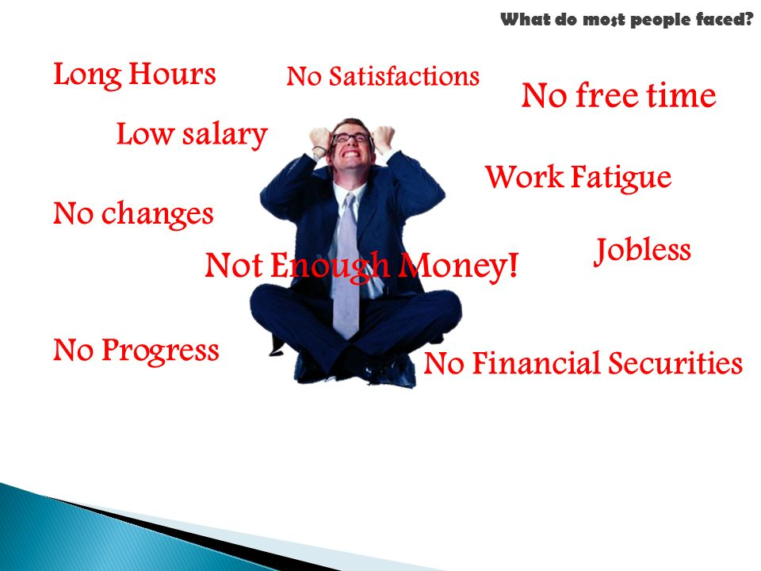
What do most people faced?

Slide 5
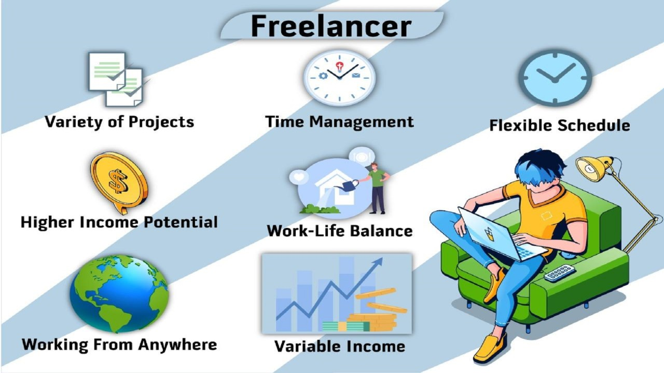
Freelancing?

Slide 6

II. General context of the project

Slide 7
General context of the project
The project aims to develop an online platform that allows freelancers to showcase their skills and services, while clients can post projects or tasks for which they are seeking talent.
The platform connects both parties and provides features for project management, payments, and evaluations.

Slide 8



Tools Used
Streamlined code editor
Modern web framework
Data modeling tool

Slide 9



JavaScript runtime environment
Tools Used
Web server framework
NoSQL database
system

Slide 10
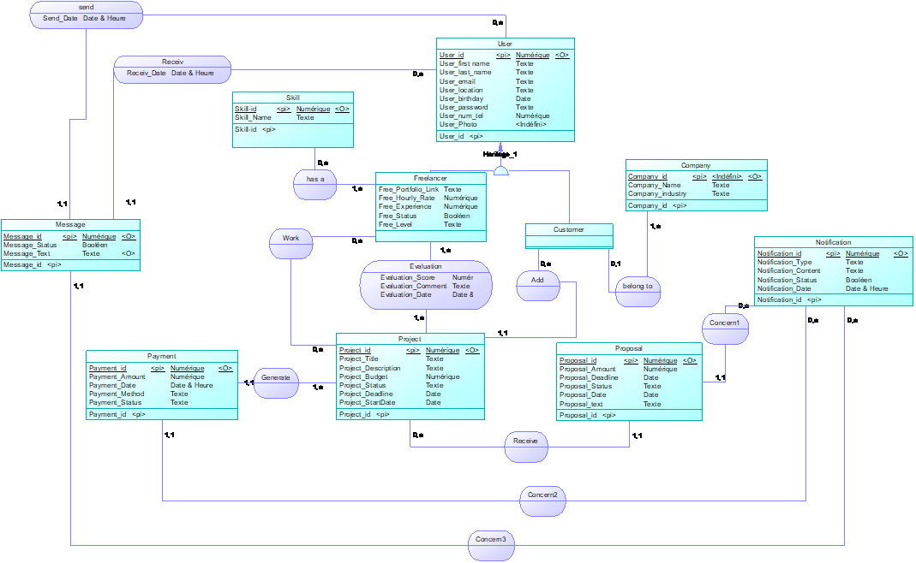
III. Analysis and Architecture

Slide 11
List of Entities
Entity | Description of the entity
User | Gathers information about users
Freelancer | Gathers information about freelancers
Customer | Gathers information about customers
Company | Gathers information about companies
Project | Gathers information about projects
Proposal | Gathers information about proposals
Skill | Gathers information about skills
Message | Gathers information about messages
Payment | Gathers information about payments
Notification | Gathers information about notifications

Slide 12
List of Relations
Relation | Entities | Cardinalities
Add | Customer - Project | 0,n – 1,1
Belong to | Customer - Company | 0,1 – 1,n
Work | Freelancer - Project | 0,n – 0,n
Evaluation | Freelancer - Project | 1,n – 1,n
Receive | Project - Proposal | 0,n – 1,1
Generate | Project - Payment | 1,n – 1,1
Send | User - Message | 0,n – 1,1
Receiv | User - Message | 0,n – 1,1
Has a | Freelancer - Skill | 1,n – 0,n
Concern1 | Notification - Proposal | 0,n – 1,1
Concern2 | Notification - Payment | 0,n – 1,1
Concern3 | Notification - Message | 0,n – 1,1

Slide 13
Rules
• A user can be a client or a freelancer.
• A client can post multiple projects.
• A freelancer can submit multiple proposals.
• A project can receive multiple proposals.
• An accepted proposal generates a single payment.
• A completed project receives an evaluation from the client.
• A notification is sent for every new proposal, payment, or message.

Slide 14
Conceptual Data Model

Slide 15
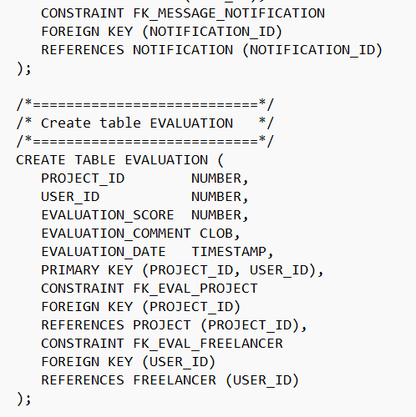
IV. Implementation and Data Insertion

Slide 16
Generated Tables
USERS (USER_ID, NAME, USER_LAST_NAME, USER_EMAIL, USER_LOCATION, USER_BIRTHDAY, USER_PASSWORD, USER_NUM_TEL, USER_PHOTO)
PROJECT (PROJECT_ID, USER_ID#, PROJECT_TITLE, PROJECT_DESCRIPTION, PROJECT_BUDGET, PROJECT_STATUS, PROJECT_DEADLINE, PROJECT_STARTDATE)
PROPOSAL (PROPOSAL_ID, PROJECT_ID#, FREELANCER_ID#, NOTIFICATION_ID#, PROPOSAL_AMOUNT, PROPOSAL_DEADLINE, PROPOSAL_STATUS, PROPOSAL_DATE, PROPOSAL_TEXT)

Slide 17
Generated Tables
CUSTOMER (USER_ID, COMPANY_ID#, NAME, USER_LAST_NAME, USER_EMAIL, USER_LOCATION, USER_BIRTHDAY, USER_PASSWORD, USER_NUM_TEL, USER_PHOTO)
FREELANCER (USER_ID, NAME, USER_LAST_NAME, USER_EMAIL, USER_LOCATION, USER_BIRTHDAY, USER_PASSWORD, USER_NUM_TEL, USER_PHOTO, FREE_PORTFOLIO_LINK, FREE_HOURLY_RATE, FREE_EXPERIENCE, FREE_STATUS, FREE_LEVEL)
COMPANY (COMPANY_ID, COMPANY_NAME, COMPANY_INDUSTRY)
SKILL (SKILL_ID, SKILL_NAME)
HAS_A (SKILL_ID#, USER_ID#)

Slide 18
Generated Tables
NOTIFICATION (NOTIFICATION_ID, NOTIFICATION_TYPE, NOTIFICATION_CONTENT, NOTIFICATION_STATUS, NOTIFICATION_DATE)
MESSAGES (MESSAGE_ID, USER_ID#, RECEIVER_ID#, NOTIFICATION_ID#, MESSAGE_STATUS, MESSAGE_TEXT, SEND_DATE, RECEIV_DATE)
EVALUATION (PROJECT_ID#, USER_ID#, EVALUATION_SCORE, EVALUATION_COMMENT, EVALUATION_DATE)
PAYMENT (PAYMENT_ID, PROJECT_ID#, NOTIFICATION_ID#, PAYMENT_AMOUNT, PAYMENT_DATE,
PAYMENT_METHOD, PAYMENT_STATUS)
WORK (PROJECT_ID#, USER_ID#)

Slide 19
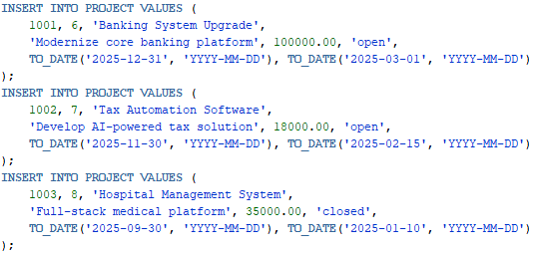
Populating the database

Slide 20

V. Database Querying

Slide 21
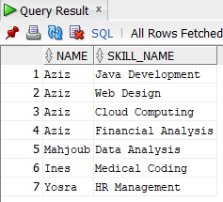
Database Querying
The list of all freelancers along with the skills they possess :
SELECT F.NAME, S.SKILL_NAME
FROM FREELANCER F
JOIN HAS_A H ON F.USER_ID = H.USER_ID
JOIN SKILL S ON S.SKILL_ID = H.SKILL_ID;

Slide 22
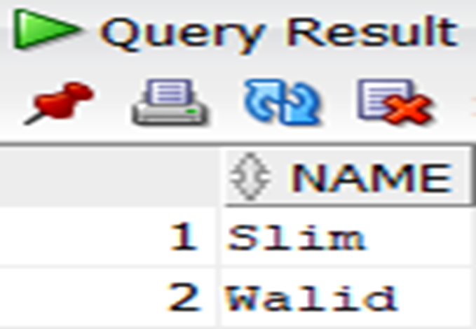
Database Querying
The list of clients who have made payments greater than $1000 for their projects :
SELECT DISTINCT C.NAME
FROM CUSTOMER C
JOIN PROJECT P ON C.USER_ID = P.USER_ID
JOIN PAYMENT PA ON PA.PROJECT_ID = P.PROJECT_ID
WHERE PA.PAYMENT_AMOUNT > 1000;

Slide 23
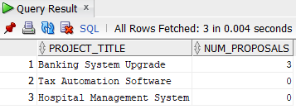
Database Querying
The list of all projects with the total number of proposals received for each :
SELECT P.PROJECT_TITLE,
(SELECT COUNT(PR.PROPOSAL_ID)
FROM PROPOSAL PR
WHERE PR.PROJECT_ID = P.PROJECT_ID) AS NUM_PROPOSALS
FROM PROJECT P;

Slide 24
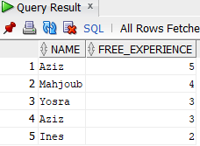
Database Querying
The list of all freelancers ordered by their experience level, from the most to the least experienced :
SELECT NAME, FREE_EXPERIENCE
FROM FREELANCER
ORDER BY FREE_EXPERIENCE DESC;

Slide 25

VI. Web Application Implementation

Slide 26
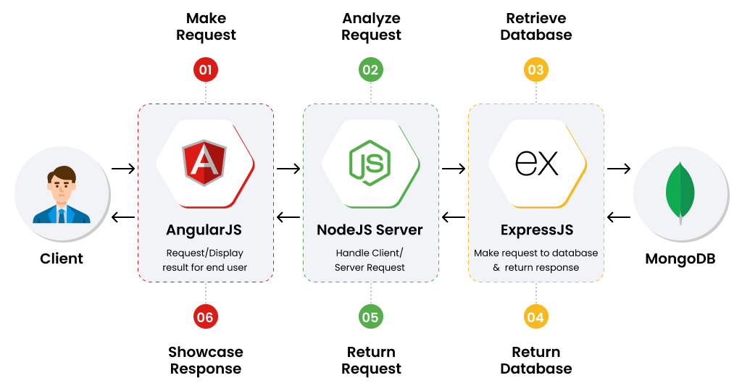
Web Application Implementation
Overall Architecture of the Web Application :
Backend: Node.js + Express
Frontend: Angular
Database: MongoDB + Mongoose
Development: Visual Studio Code
Modeling: PowerAMC

Slide 27
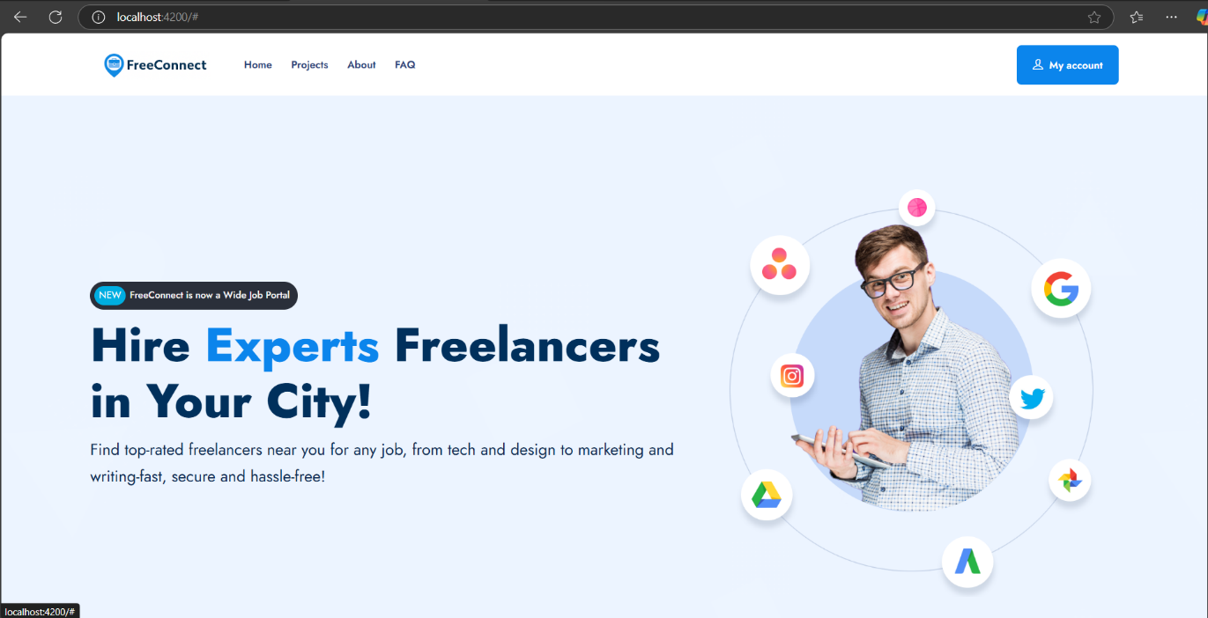
Web Application Implementation
The homepage:
. Clean, intuitive interface
. Easy access to all major sections

Slide 28
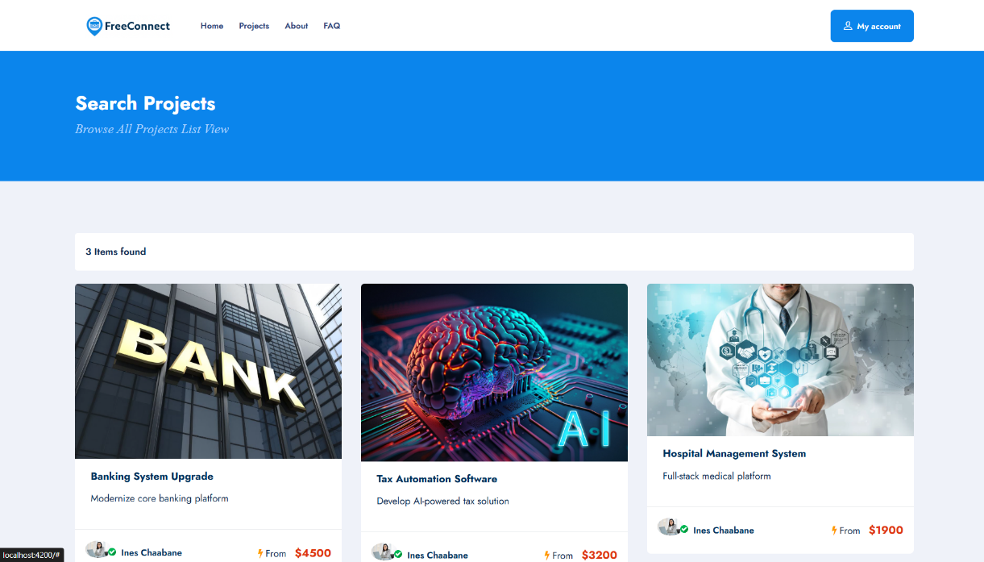
Web Application Implementation
The Projects section:
. Clean, intuitive interface
. Easy access to all major sections

Slide 29
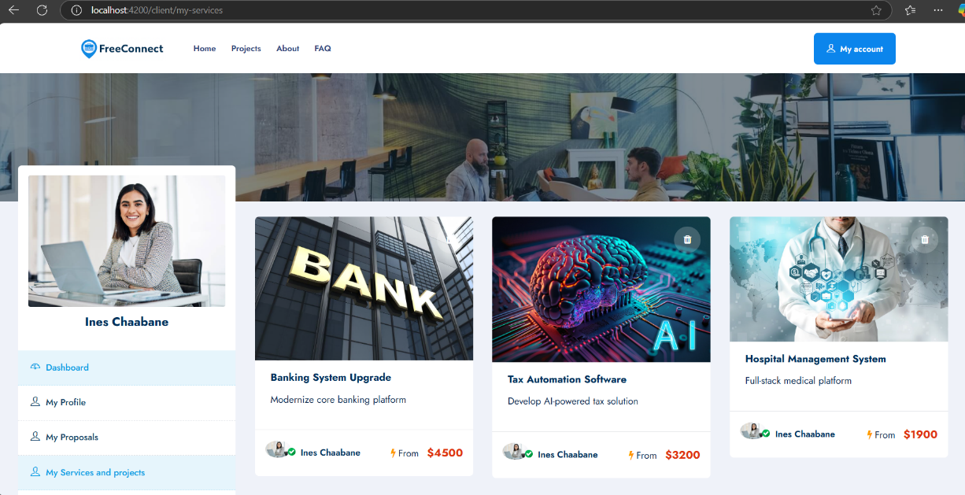
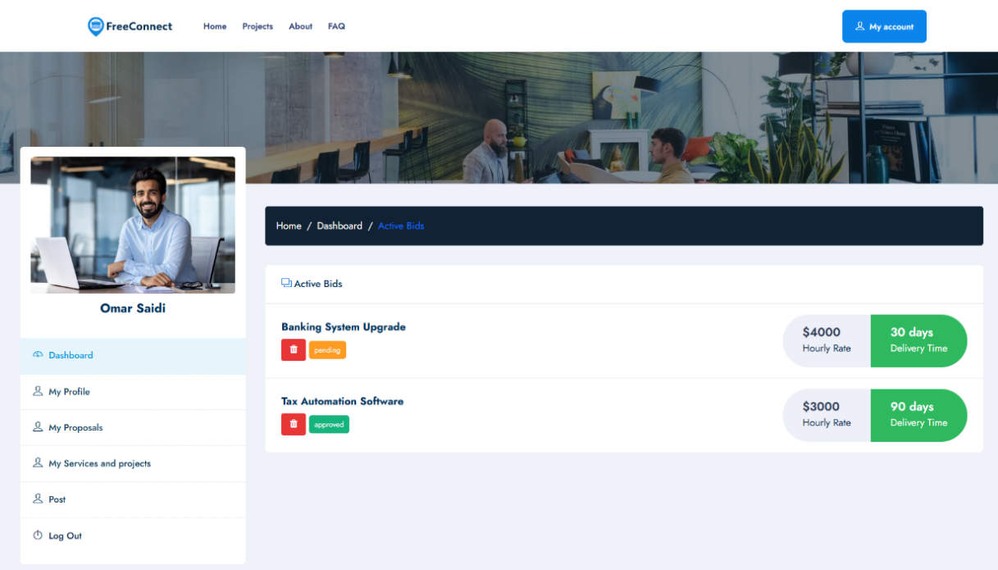
Web Application Implementation
My Services, Projects & Proposals:
. Clients can view and manage the projects they’ve posted
. Freelancers can track all submitted proposals with real-time status updates
. Both sections are dynamically updated via the Post feature

Slide 30

VII. Conclusion and Perspective

Slide 31
Conclusion and Perspective
The database is consistent.
The project effectively achieved its intended goals.
The platform remains open to future enhancements.

Slide 32
Thank you for your attention
We are open to your questions.

